Slide 1
NYCU DLP
Lab4 - Conditional sequence-to-sequence VAE
2021 Summer
李美慧
August 3, 2021

Slide 2
Outline
Lab Objective
Important Date
Lab Description
Scoring Criteria
Implement Hints

Slide 3
Lab Objective
In this lab, you need to implement a conditional seq2seq Variational Autoencoder (VAE) for English tense conversion and generation.
Tense conversion (4 tenses)
E.g. ‘access’ to ‘accessing’, or ‘accessed’ to ‘accesses’
Word Generation
Gaussian noise + tense -> access, accesses, accessing, accessed

Slide 4
Important Date
Report Submission Deadline: 8/17 (Tue.) 11:55 a.m.
Demo date: 8/17 (Tue.)
Zip all files into one file
Report (.pdf)
Source code
Name it like「DLP_LAB4_yourstudentID_name.zip」
ex: 「DLP_LAB4_309551027_李美慧.zip」

Slide 5
Lab Description
Variational Autoencoder
Seq2Seq Model
Reparameterization Trick
KL Cost Annealing
Conditional VAE

Slide 6
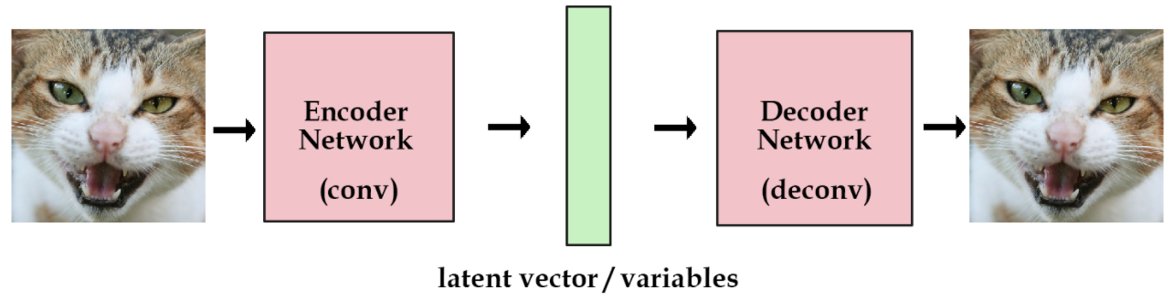
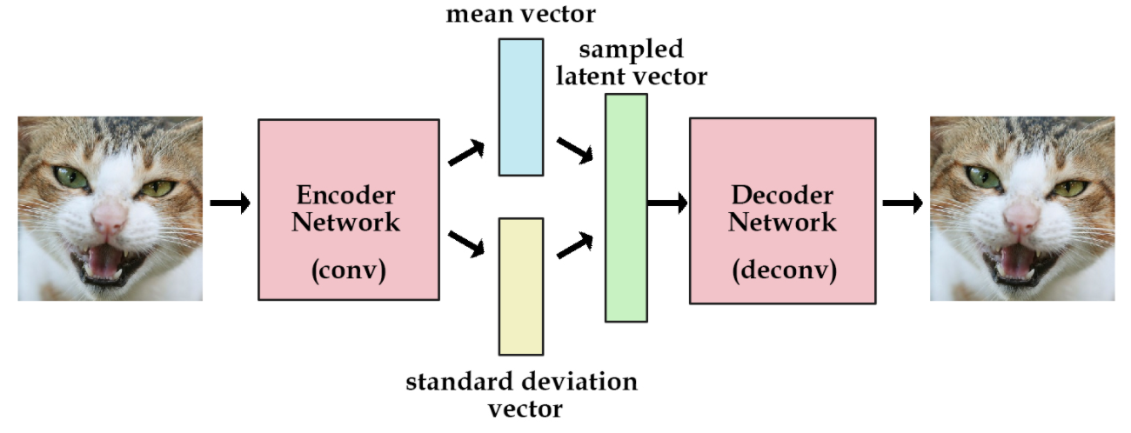
Lab Description - VAE
AE
VAE

Slide 7
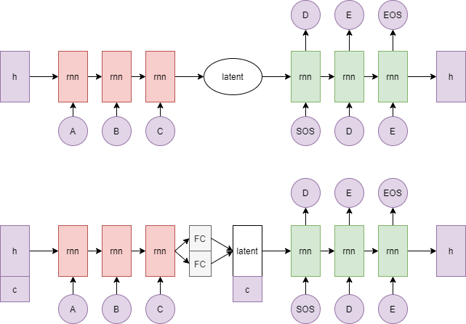
Lab Description - Seq2Seq
Seq2Seq AE
Seq2Seq CVAE

Slide 8
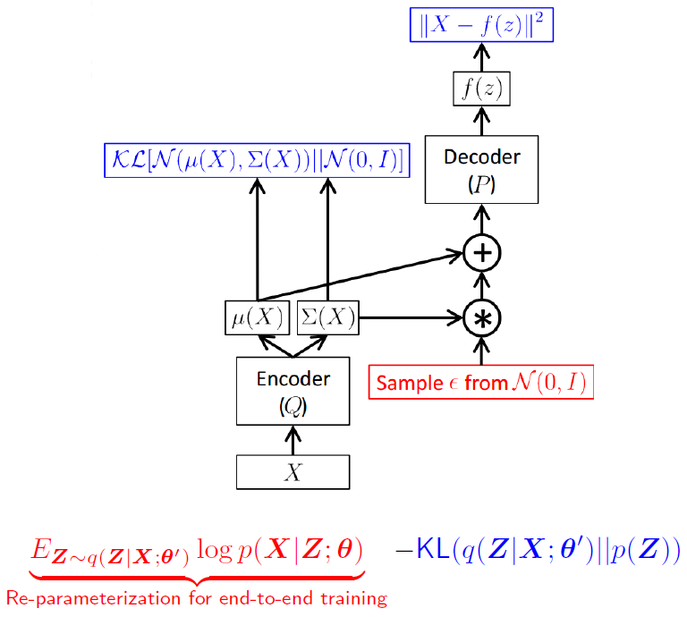
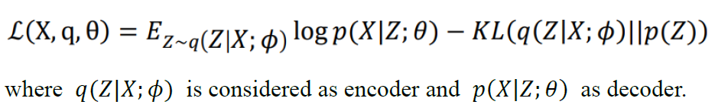
Lab Description – Reparameterization Trick
Log variance
Output should be log variance (not variance)

Slide 9
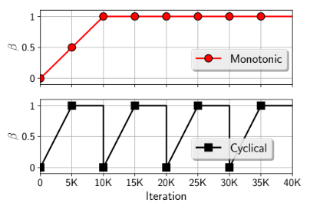
Lab Description - KL Cost Annealing
Initially set your KL weight to 0
Maximum value is 1

Slide 10
Lab Description - Conditional VAE
Simply concatenate to the hidden_0 and z
Embed your condition to high dimensional space (or simply use one-hot)

Slide 11
Lab Description – Other details
The encoder and decoder must be implemented by LSTM.
You should not adopt attention mechanism.
The loss function is nn.CrossEntropyLoss().
The optimizer is SGD.

Slide 12
Lab Description – Other details
Adopt BLEU-4 score function in NLTK.
Average 10 testing scores
Adopt Gaussian_score() to compute the generation score
Random sample 100 noise to generate 100 words with 4 different tenses (totally 400 words)
4 words should exactly match the training data.

Slide 13
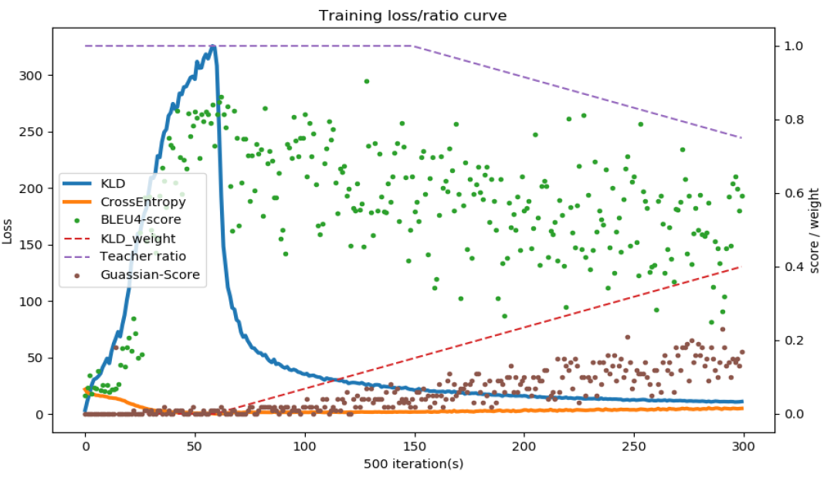
Lab Description – Requirements
Modify encoder, decoder, and training functions
Implement evaluation function, dataloader, and reparameterization trick.
Adopt teacher-forcing and KL loss annealing in your training processing.
Plot the losses, scores and ratios.

Slide 14
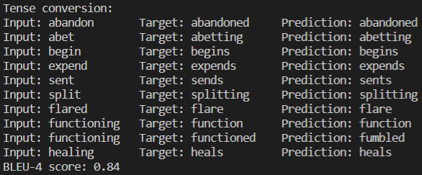
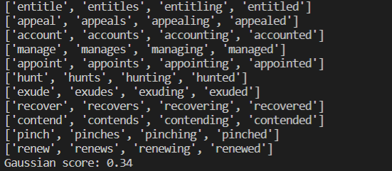
Lab Description – Requirements
Output examples (tense conversion & Gaussian noise with 4 tenses)

Slide 15
Lab Description – Hints
Training method
Input the word with the tense and the output should also be the same word.
Convert each character to a number (dictionary)
Model weights
Strongly recommend you save your model weights during training
Teacher forcing ratio and KL weight
Influential to the performance of model
You can first set your KL weight to 0 to see whether your model works.

Slide 16
Scoring Criteria - Report (50%)
Introduction(5%)
Derivation of CVAE(5%)
Derivation of KL Divergence loss (5%)
Implementation details(15%)
Describe how you implement your model. (e.g. dataloader, encoder, decoder, etc)
Specify the hyperparameters (KL weight, teacher forcing ratio, etc.) Notice: You must prove that your word generation is produced by Gaussian noise (paste/screenshot your code)
Results and discussion(20%)
Plot the losses, scores and ratios, show results of tense conversion and generation. (5%)
Discuss the results according to your settings. (15%) Notice: This part mainly focuses on your discussion, if you simply just paste your results, you will get a low score

Slide 17
Scoring Criteria - Demo(50%)
Capability of tense conversion on testing data. (10%)
score >= 0.7 ---- 100%
0.7 > score >= 0.6 ---- 90%
0.6 > score >= 0.4 ---- 80%
score < 0.4 ---- 0%
Capability of word generation. (Gaussian noise + tense) (20%)
score = Gaussian_score() (100 words with 4 tenses)
score >= 0.3 ---- 100%
0.3 > score >= 0.2 ---- 90%
0.2 > score >= 0.05 ---- 80%
Otherwise ---- 0%
Questions (20%)

Slide 18
Implement Hints
Sampling
torch.randn(*size)
ex : torch.randn(*size) * exp(0.5 * var) + mean
torch.randn_like(input)
Pytorch seq2seq tutorial
https://pytorch.org/tutorials/intermediate/seq2seq_translation_tutorial.html

Slide 19
Supplementary Materials

Slide 20
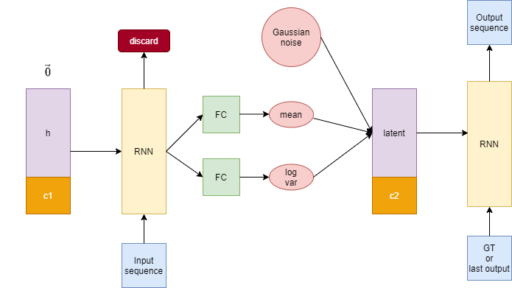
GRU to LSTM

Slide 21
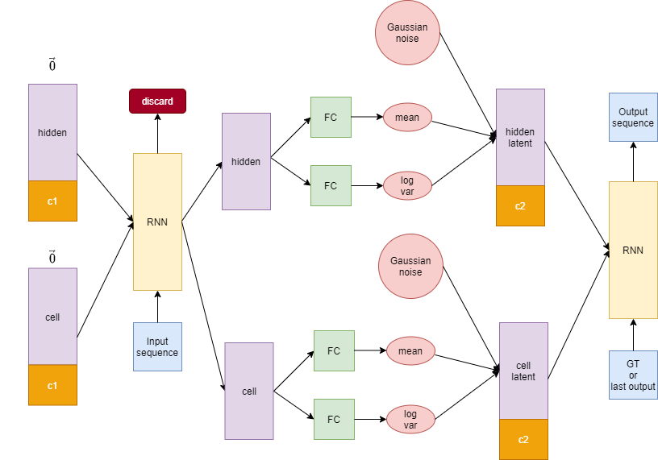
GRU to LSTM (cont’d)

Slide 22
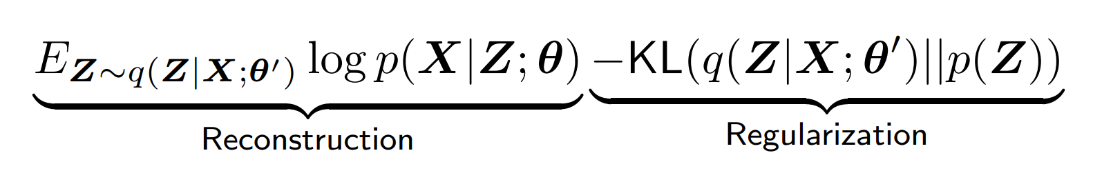
Loss
Cross Entropy Loss
KL-divergence Loss
Reconstruction result
Generation result
BLEU score
Gaussian score

Slide 23
Other References
Variational Autoencoders Explained
https://kvfrans.com/variational-autoencoders-explained/
Understanding Variational Autoencoders (VAEs)
https://towardsdatascience.com/understanding-variational-autoencoders-vaes-f70510919f73

